Slide 1
Machine Learning Limitations
UIUC ECON 490: Applied Machine Learning in Economics

Slide 2
What Machine Learning offers Economics
Predict consumer preferences
Predict recession probability
Predict central bank interest rate changes
Predict fraud
Predict neighborhood economic disparity from street images
Extract information from text
Guide econometric analysis with clustering

Slide 3
Limitations of Machine Learning
Econometrics and causal relationships

Slide 4
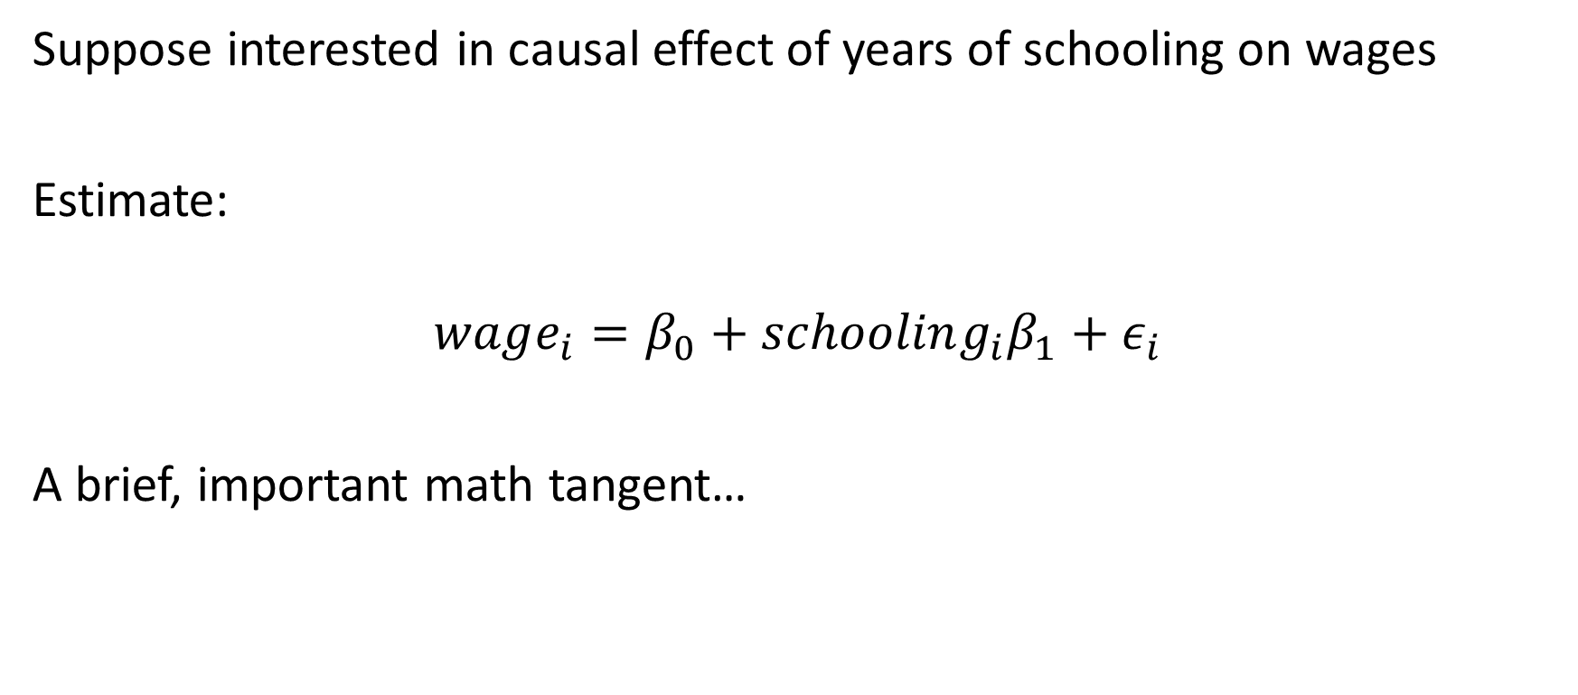
Why ML is not causal
Suppose interested in causal effect of years of schooling on wages
Estimate:
$$wage_{i}=β_{0}+schooling_{i}β_{1}+ε_{i}$$
A brief, important math tangent…

Slide 5
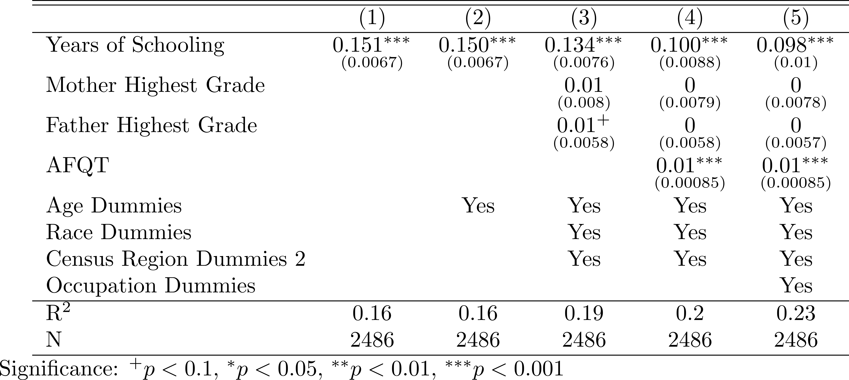
Omitted Variable Bias: Log (income) – NLSY79

Slide 6
What ML Cannot Do
Most economic (causal) questions
Does increasing the minimum wage reduce employment?
Does a college degree increase your income?
Were stay-at-home orders effective?
Will a merger increase market power?
How much will consumption change given a tax increase?
Require econometrics techniques

Slide 7
Causal Question Settings
Randomized control trial
You determine treatment and control groups
You determine treatment dosage
Ex) AB testing
Natural experiment
Look for natural experiments
Ex) Dotcom bubble, Moving to Opportunity, admission to ivy league
MANY OBSTACLES (i.e. OVB) – requires assumptions
Structural modelling
Mathematical models – shifts in housing demand
Calibrated to real data
Requires more assumptions

Slide 8
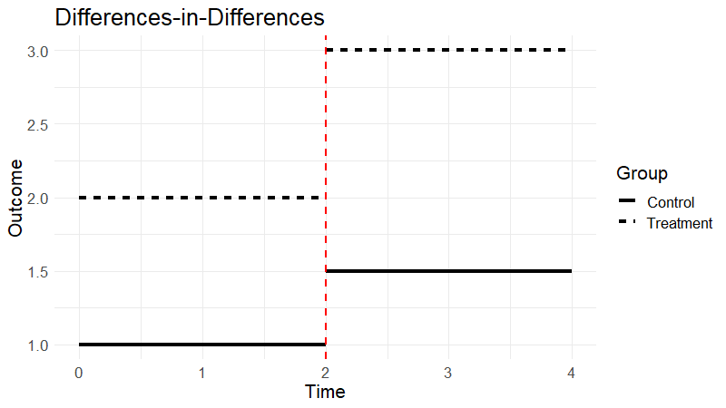
Causal Techniques – Difference-in-Differences
Difference 1 – Control vs treatment
Pre-treatment: 1
Post-treatment: 1.5
Difference 2 – Pre vs post
1.5 – 1 = 0.5
Performed in a regression

Slide 9
Causal Technique – Instrumental Variables
Probability of treatment depends on some random force
Which has no effect on the outcome other than through treatment
Random force: instrumental variable
Effectively, a reweighting scheme
Not the same as weighted least squares
Two stage least squares

Slide 10
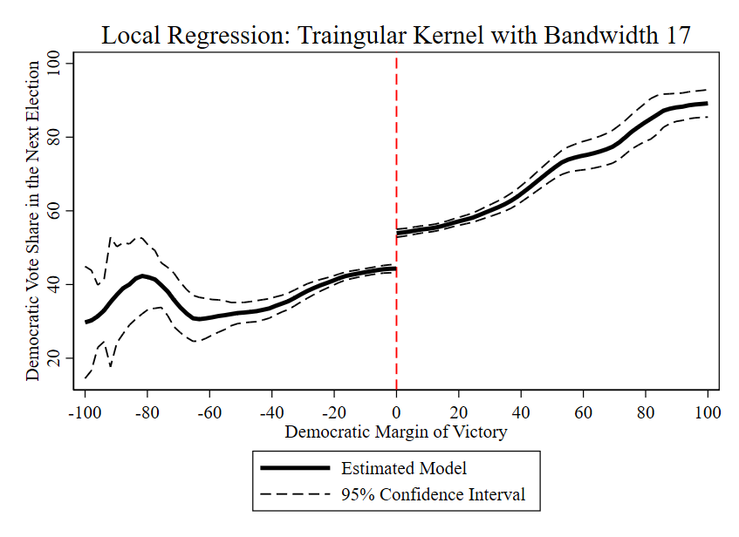
Causal Technique – Regression Discontinuity
Incumbent advantage
Treatment is discontinuously likely around some threshold in a variable
Which does not itself discontinuously affect the outcome

Slide 11
Shameless Econometrics Plug
If not, Mastering Metrics
ECON474 – Econometrics of Policy Evaluation
Identify causal relationships
Randomized experiment
Ideal setting – clear treatment and control groups
Natural experiments
Dotcom Bubble
Matching
Constructing control groups from natural experiments
Differences-in-differences
Treatment variation by group
Instrumental variables
Treatment varies by “exogeneous” variable
Regression discontinuity
Treatment varies by variable threshold – admission test scores

Slide 12
Machine Learning and Econometrics
Not substitutes
Complements
Suel et al. (2019) Measuring social, environmental and health inequalities using deep learning and street imagery
Google street images to target economic “place-based” policy
Albert et al. (2017) Using convolution neural networks and satellite imagery to identify patters in urban environments at a large scale
Identify areas for economic development without costly labor
Calvano et al. (2020) Artificial intelligence, algorithmic pricing, and collusion
IDENPENDENT reinforcement learning (NN) in finance trading leads to collusion

Slide 13
Societal Benefits of Machine Learning
Predictive power

Slide 14
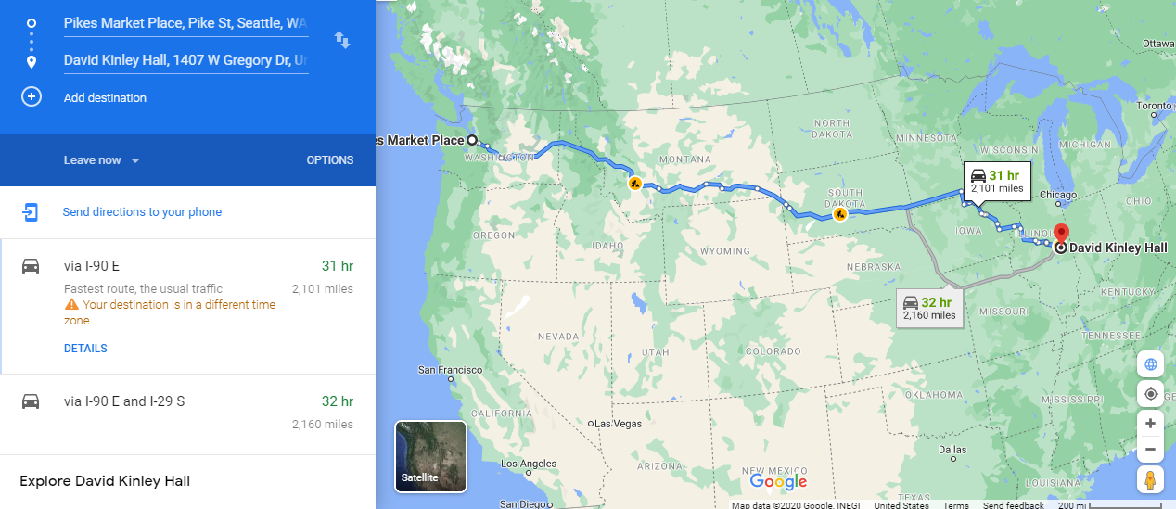
Machine Learning in your Daily Life

Slide 15
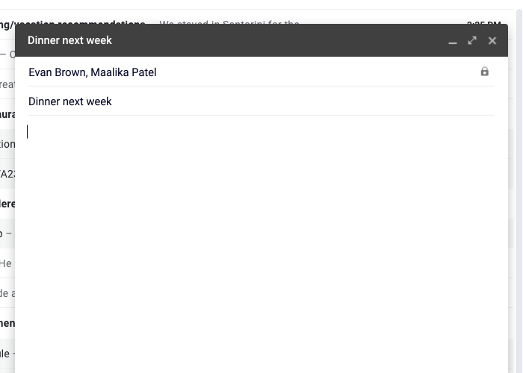
ML in your Daily Life: Autofill – Neural Networks

Slide 16

ML in your Daily Life: Voice Recognition – NN

Slide 17
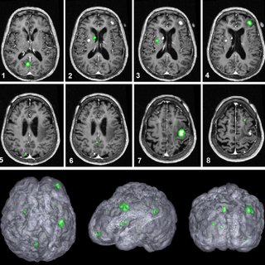
ML in (hopefully not) your Daily Life: Medical – NN

Slide 18
ML in your Daily Life
Recommender systems – Linear regression, Bayes classifier, etc.
Music – Spotify
Social media – Facebook, Twitter
Purchases – Amazon
Anomaly detection – SVM, unsupervised learning, NN
Credit card fraud
Spam emails
Spam calls?
All of these applications build off techniques we covered

Slide 19
Societal Costs of Machine Learning
Click here!

Slide 20
Tail of Two Tech Titans
Myspace – 2003 (eh?)
Facebook – 2004
Put your life online
Twitter – 2006
Put your thoughts online

Slide 21
Tail of Two Tech Titans – Click Bait
How do they make money?
ADVERTISEMENTS
Clicks on advertisements
What you click on identifies what you like
Duration of what you view identifies what you like
Send you “test posts” to tune predictions
Gathering more data to improve “MSE”
Target advertisements to individuals – micromarketing
If you aren’t paying, you are the product.

Slide 22
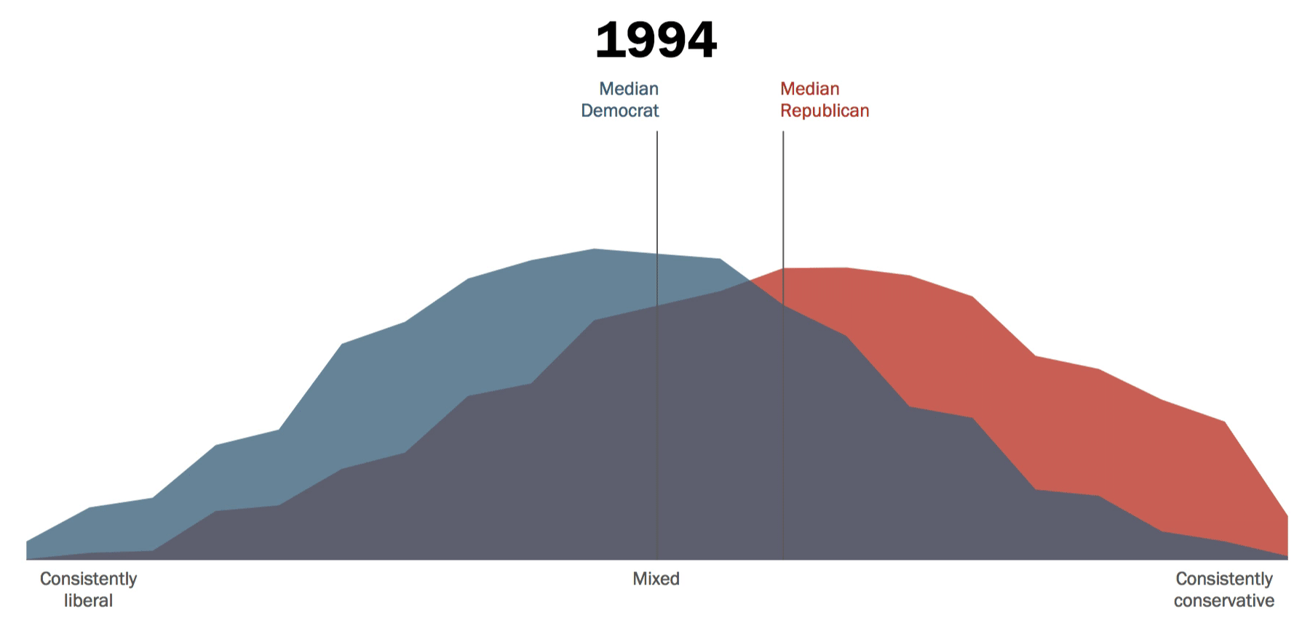
Political Polarization

Slide 23
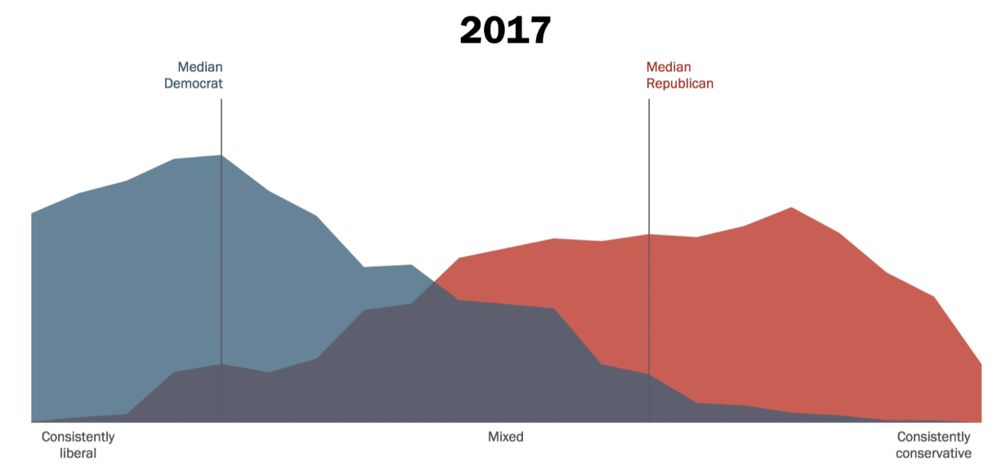
Political Polarization

Slide 24

The Social Dilemma – Netflix

Slide 25
The Social Dilemma – Netflix
Social Media, self harm, and suicide
Past 10 years
Rise in self-harm rates of teenagers
Rise in suicide rates of teenagers
Cyberbullying
Hiding behind the keyboard
Unobtainable life standards
Only post positives of life
Rarely, if ever, post failures
Unobtainable beauty standards
Filters and photoshop

Slide 26

Xmas with the Fam

Slide 27

Xmas with the Fam – Filter

Slide 28

Xmas with the Fam – Redeye

Slide 29
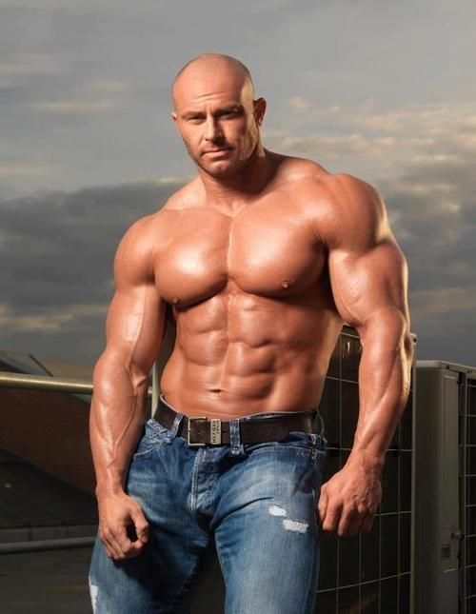
Xmas with the Fam

Slide 30
Spread of False Information
Vosoughi et al. (2018) “The spread of true and false news online”
False news spreads 6 times faster than true news
Using ML techniques…
126,000 tweets from 2006-2017
Veracity evaluated by six independent fact checking organizations
Findings
False information spread by “small” users, not celebrities or robots
False information has “novel” factor
Fear, disgust, surprise
True information
Sadness, joy, trust, anticipation

Slide 31
Echo Chambers and Debunking
Walter Quattrociocchi and friends – academic papers
Echo chambers – Similar people, recommend similar posts
Maximize clicks: different people do not see same posts
Even if it is false
“Misinformation thrives”
Debunking
Providing true evidence reinforces prior beliefs – confirmation bias
Ex) Autism and vaccine conspiracy theory
Exposure to debunking made people 30% more likely to continue reading conspiracy theories

Slide 32
What now?
Realign incentives
Requires economic thinking
It is up to you

Slide 33
Concluding thoughts
Machine learning is a phenomenal tool
Advanced models predict very accurately
You now know the building blocks to these models
How you use the tools is what matters
Thank you!

